Slide 1
Faster sound waves
Sound waves can be made with a loudspeaker.
The loudspeaker makes a louder sound wave when it moves a bigger distance in and out.
A loudspeaker vibrating to make a sound wave.
Bigger vibrations make a sound wave that is louder.

Slide 2
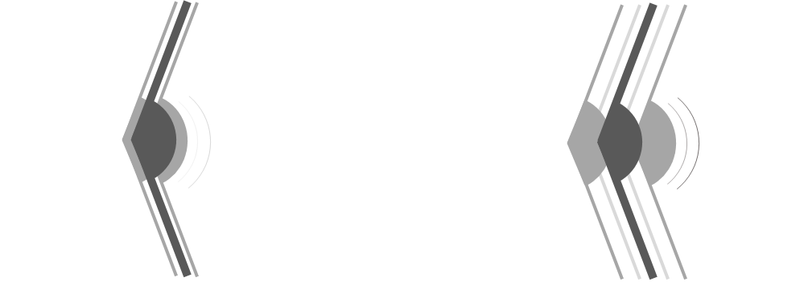
Faster waves
1a. Which sound wave moves faster through the air?
X
Y
A
Wave X moves faster.
B
Wave Y moves faster.
C
Both waves move at the same speed.

Slide 3
Faster waves
1b. What is the best reason for your last answer?
X
Y
A
Both waves move through the same air.
B
It has more energy.
C
It has more force.
D
Fewer air particles need to move.

Slide 4
Faster sound waves
Sound waves can have different frequencies.
The loudspeaker has a higher frequency when it moves in and out more quickly.
A high frequency sound wave has a high note. It sounds squeaky.
A loudspeaker vibrating to make a sound wave.
Faster vibrations make a sound wave with a higher frequency.

Slide 5
Faster waves
2a. Which sound wave moves faster through the air?
X
Y
A
Wave X moves faster.
B
Wave Y moves faster.
C
Both waves move at the same speed.

Slide 6
Faster waves
2b. What is the best reason for your last answer?
X
Y
A
Both waves move through the same air.
B
It has more energy.
C
It has more force.
D
Fewer air particles need to move.

